Slide 1
Group 1 MBA 617
Mathieu Derache, Anci Dy, Nick Lukac, Isabella Revstedt, Brian Tapé
Notes:
https://www.kaggle.com/datasets/pranalibose/amazon-seller-order-status-prediction?resource=download
^Link to where we downloaded the dataset from

Slide 2
Agenda
Business Understanding & Project Introduction
Data Selection
Data Understanding & EDA
Model Applications
Model Evaluations
Summary and Deployment
Notes:
anci

Slide 3
Introduction & Problem
The Business Problem
Product returns and logistics inefficiencies
Negative impact on:
profit margins, inventory planning, and customer satisfaction
Key Question: How can predictive analytics help identify return patterns?
Notes:
Brian
Our project focuses on addressing logistics inefficiencies caused by product returns. Returns not only impact customer satisfaction but also lead to increased operational costs.
We aim to explore how predictive analytics can help identify patterns and trends
Focus: Reducing logistics inefficiencies caused by product returns
Returns negatively impact profit margins, inventory planning, and customer satisfaction
Use predictive analytics to uncover patterns that help anticipate returns
Value: Enables better decision-making across fulfillment, customer service, and product quality control

Slide 4
Project Idea/Hypothesis
Objective: Predict which orders are likely to be returned
Hypothesis: Customer behavior, order details, and product attributes can be used to predict return likelihood.
Potential Questions to Explore:
Which product categories are being returned?
Are there delays or issues in the orders?
Which product categories have higher return rates
Notes:
Brian
Objective
Our primary objective is to identify behaviors and trends that predict whether an order is likely to be returned
Hypothesis: Customer behavior, order details, and product attributes can be used in predicting return likelihood
Exploring different patterns and questions
Which items sell best? Any specific product categories?
Can we create a model to predict product returns?
Are there patterns in product prices and quantity for returns?
Which product categories have higher return rates—and why?
Do delays, discounts, or demographics affect return behavior?
Can we identify risk factors before a product is returned?

Slide 5
The Dataset
Obtained from a public site (Kaggle)
Non_returned vs returned
10,000 rows
17 columns
Return Status, Return reason, gender, product category
Product information, quantity, order totals
1 year of data collected
Notes:
Brian
Reason for the selection of this specific data set.
Synthetic data set from Kaggle that has lots of data rows and multiple informational columns.
The data set includes important details like return status, return reasons, product categories, discounts, order totals, and user cities and user genders– All helping to understand the process and help us form an idea if the packages being kept or are being shipped back to the seller.
This dataset also includes a good size of data from an entire year to do some preliminary analysis for a growing business and look at the emerging trends. Having data from various seasons and a range of products gives us a good database to start analyzing and creating suggestions and improvements for the company.

Slide 6
Data Understanding
Types of data
Integer, object, float
Missing values, outliers, duplicates
Return Reason, Days to return, Return Date
Key columns
Identify trends, patterns
Notes:
Data Understanding –Mathieu
Exploring the data and understanding its structure, quality and key characteristics. Checking for missing values, understanding the variable types and identifying obvious errors or outliers.
We are looking into whether a product will be returned or not and explain customer’s product return behavior. Our dataset contains integers, floats, and objects. Which variables are most affected and which variables are key variables to answer to our original question of why a product is returned.
Data collected based on real world patterns, upon a year of time.
We checked for missing values, duplicates, outliers, unusual values, the data types of the variables.
We found missing values in return date, return reason, and days to return.
We saw no duplicates in our dataset.
We found understanding for key columns like product category, return reason, price, return status, age, gender.
These will be useful in comparing future trends and seeing the connections between them and the product being kept or returned.
These are key metrics in how our data will be analyzed for our project and predicting patterns

Slide 7
Data Preparation
Inspecting and becoming familiar with dataset
head(), info(), describe(), shape().
Check & handle for duplicates, outliers, missing values
Encode Data
Compatibility with the models
Helps run clean model test
Notes:
Data Preparation –Mathieu
Cleaning, transforming and preparing the data – to ensure an accurate analysis when we run certain models and tests
We cleaned the data removing duplicates, handling missing values
We can observe negatives values in our days to return columns that we needed to clean up to take only those that are over 0 for compatibility with our models because irrelevant values can confuse ML models.
There were no duplicates in the data
We did not have to handle missing values as they would be irrelevant in our analysis.
We also Encoded in binary genders, product category, and return status columns, since some of the data was recorded differently. Our model will interpret those keys features, we needed to encode them to numerical variables rather than categorical.
Gender encoded is to determine if gender influences returns, do returns differ by gender ? Would Male and female buy and return different product categories, etc ?
Do I encode return reason to find patterns with the reason ?
This helps ensure our model can read and interpret our data when we run it through jupyter or google collab.

Slide 8
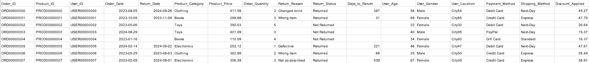
Visuals
Notes:
Mathieu

Slide 9
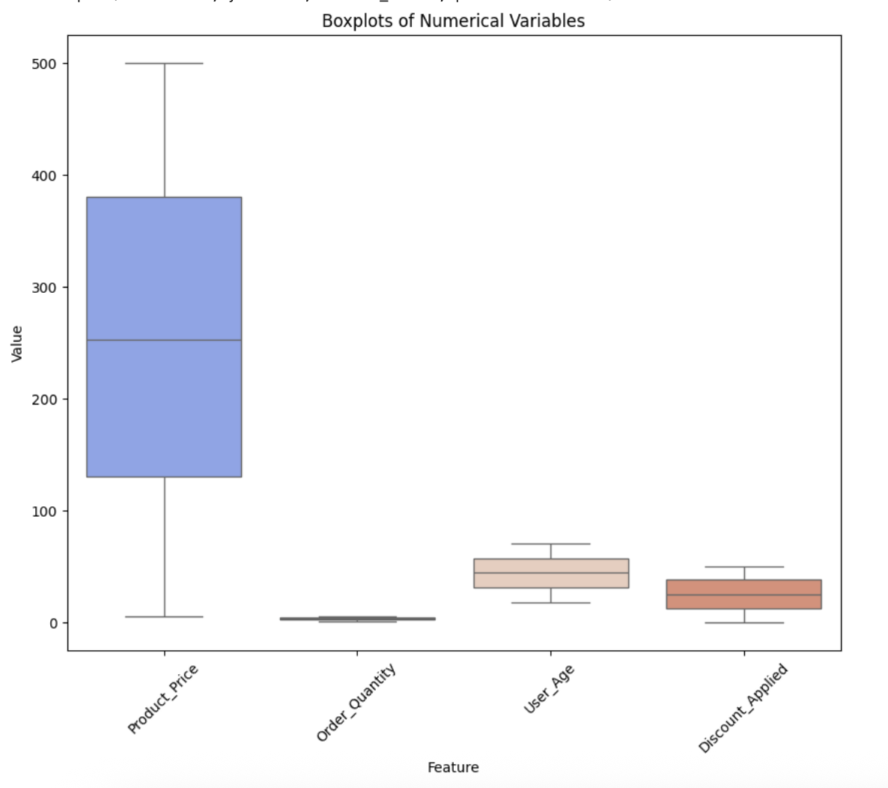
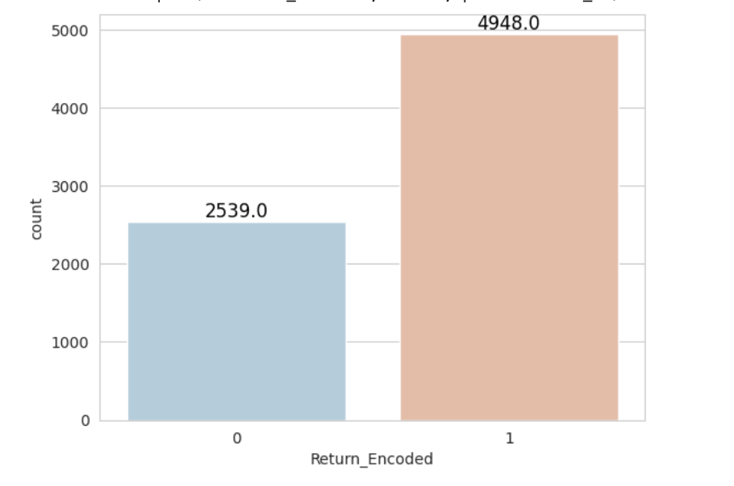
Visuals
Notes:
Mathieu

Slide 10
Predicting Return Status
Use logistic classification models – Random Forest
Target variable “Return_Status”
Predicts whether orders will be kept or returned based on key variables
Data preprocessing: removed columns related to the return information
Notes:
Anci
Part of our project was focusing on being able to predict if an order will be returned or kept. A logistic model to apply is random forest. We had to encode certain columns to be binary data types and ensure the test would run properly.
We also did a train test split so our model could be trained on part of the data and then test it on data it has not seen before. This would help prevent a biased model that memorized simple patterns and would see how it performs when introduced to new data.
This model was a good choice because of the size of data, how it deals with noisy or unbalanced data, and how it can capture non-linear relationships.

Slide 11
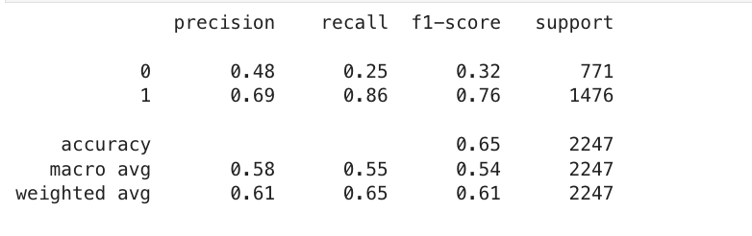
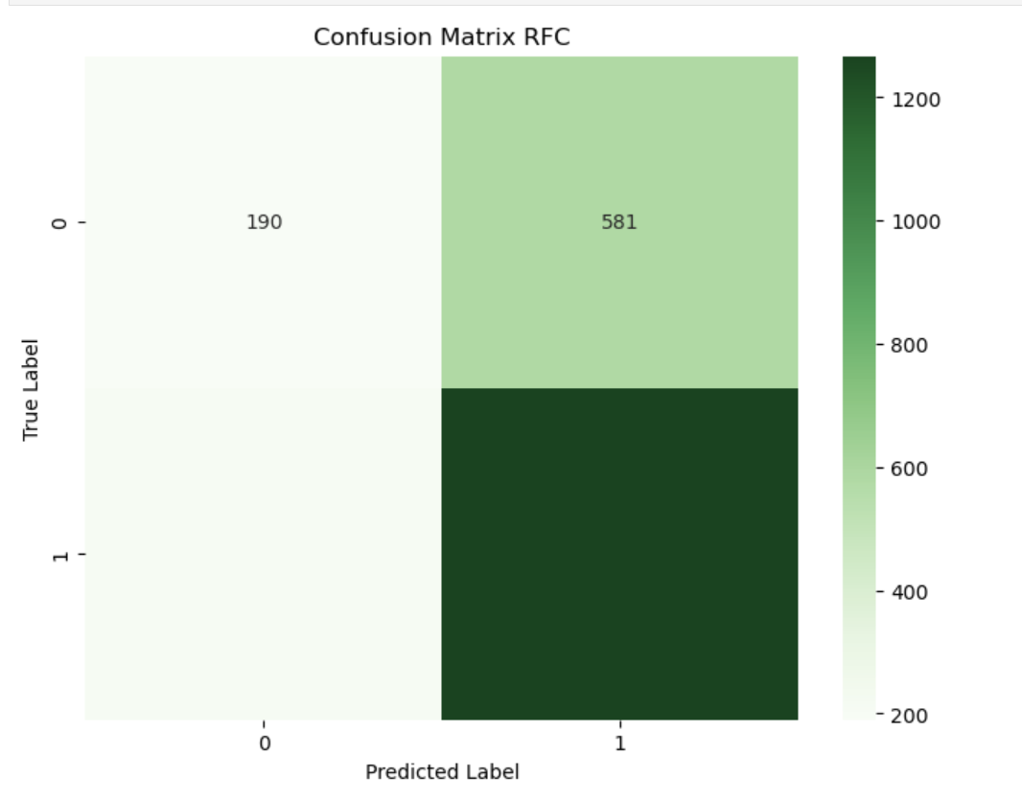
Random Forest Model Evaluation
190
581
0=Kept
1=Returned
Overall = 65% accurate
209
1267
Notes:
Anci
Our model correctly predicted package returns in about two-thirds of cases — a decent baseline, but with room for improvement, especially for Class 0.
As we can see with the model struggles with identifying kept packages — low recall in class 0 means many are misclassified as returns. However, the model does well in detecting returns — high recall in class 1 suggests the model captures most return cases reliably.
Our confusion matrix can be read as follows:
True Positives are where the model predicted a package was returned and it was correct: 1267
False positives are where the model predicted a package was returned and it was actually kept: 581
False Negatives are where the model incorrectly classified packages as being kept and a package was returned, or more simply, it missed returns: 209
True Negatives are where the model predicted packages would be kept and they were: 190

Slide 12
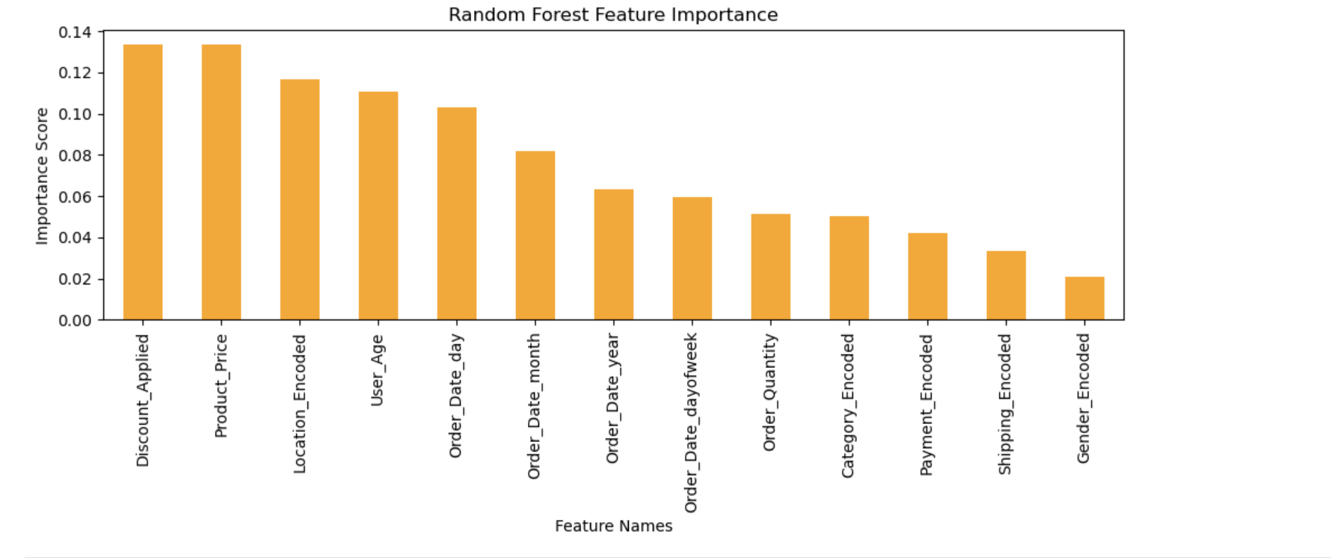
Feature Importance Random Forest
Notes:
Anci
From this visual, we see how the model ranked feature importance and what it found.
Discounts applied and product price seem to be highly impactful on returned products. This can be due to customers who receive deep discounts being more prone to returning items because of impulsive purchases or expectations misaligned with actual product quality. Higher-priced items can also be associated with buyers having higher product expectations. This may lead to returns due to unmet expectations or fewer returns due to increased purchase deliberation.
This test led to further research into what product categories were the most commonly returned.

Slide 13
Counts of Returns Per Category
Key Percentages
Home 67.37%
Books & Clothing
64.6%
Average Pricing (most to least expensive)
Clothing
Toys
Electronics
Books
Home
Category | Number Returned | Number Kept | % Returned | Average Purchase Price
Books | 1007 | 551 | 64.63% | $248.40
Clothing | 951 | 521 | 64.61% | $259.16
Electronics | 974 | 480 | 66.98% | $250.92
Home | 1035 | 501 | 67.37% | $246.56
Toys | 981 | 486 | 66.85% | $258.01
Notes:
Anci
After running the random forest test, we broke down our findings and data into the product categories and price points.
We found that even with different product categories, they are being returned in similar percentages. The smallest percentage of product returned is in the books and clothing categories with the highest return percentages being in the home product category.
Since product price was also a large factor, we looked at the average product price per category of the returned items only. This gave us this list ranking of the most to least expensive average purchase prices and seeing that while the home category was returned the most, it was on average the least expensive product price. The most expensive product returns were clothing orders, and they were returned the least.
This is an interesting find due to the strategic recommendations being applicable across all categories since the differences in percentages being returned and pricing are moderate to minimal. This does allow us to make general strategic decisions that can hopefully lower return rates below 50% and look at pricing models that may help match consumer expectations to product quality so they do not feel inclined to return them again.

Slide 14
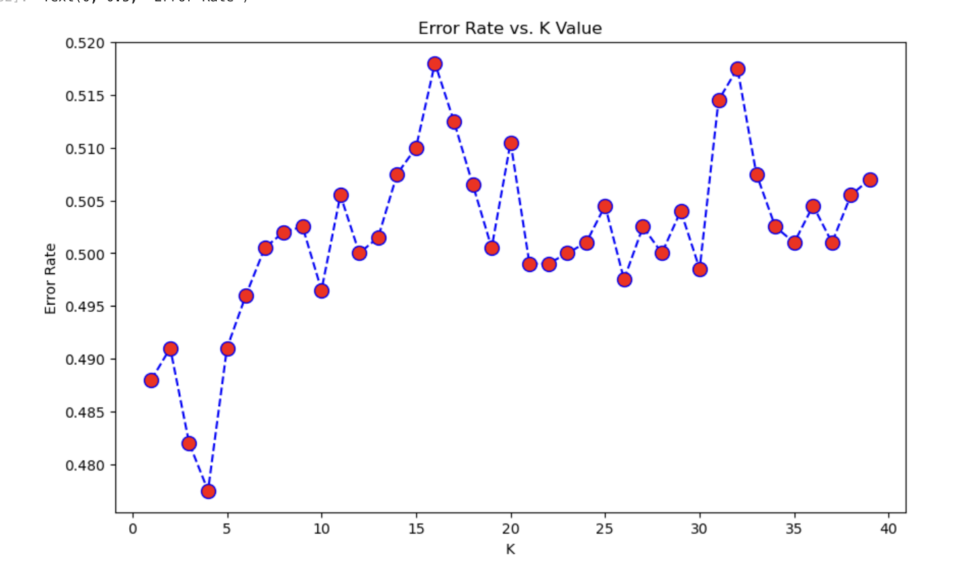
Modeling–KNN
Used to help show return status based on key purchasing features
The columns we used in this model:
Product Category
Product Price
Order Quantity
Discount Applied
Return Status
K = 4
Notes:
Anci
Other than our simple application of data observation, we ran KNN modeling.
These columns show that our target was to predict the return status again, based on these purchasing features.
Before we ran this test it was important to scale the data to ensure it was read properly and we performed the elbow method to choose the right k for the test.
We can see how it performed and if it was useful on the next slide.

Slide 15
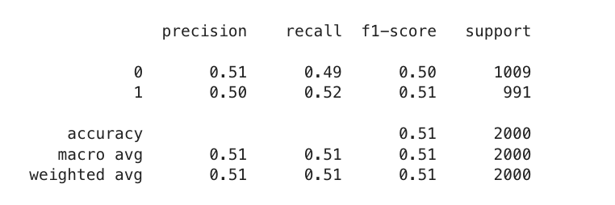
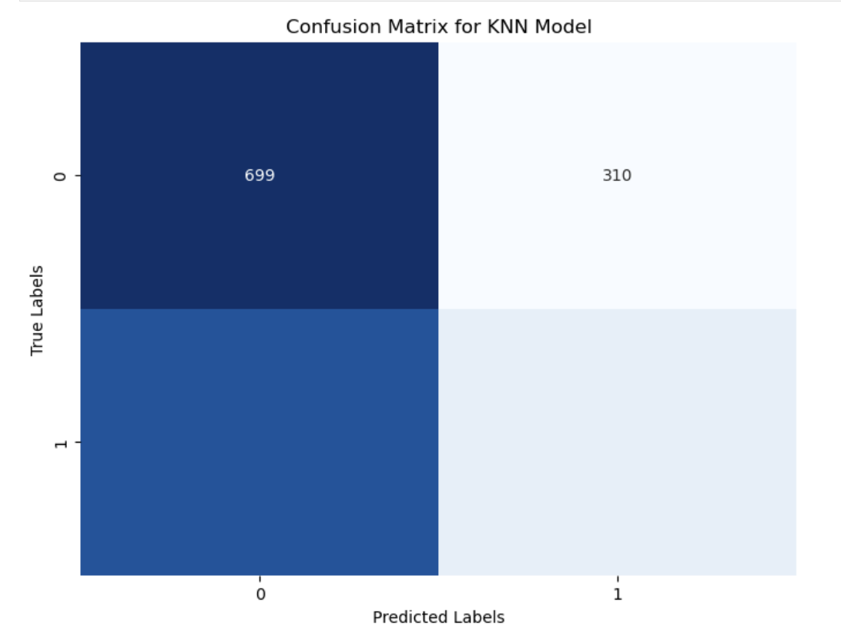
K Means Model Evaluation
499
510
51% accuracy
Not as clearly actionable
472
519
Notes:
Anci
As we can see, the overall accuracy was only 51%. This means our model could differentiate what products were kept and returned, but not much better than one of us simply guessing. Even though the model may not have shown us a strong accuracy, we can reinforce that the chosen features we chose to run in the test do not necessarily have a strong pull or influence over products being returned.
Knowing this, we can try another KNN model with different inputs to see if it gives us more actionable insights than this.

Slide 16
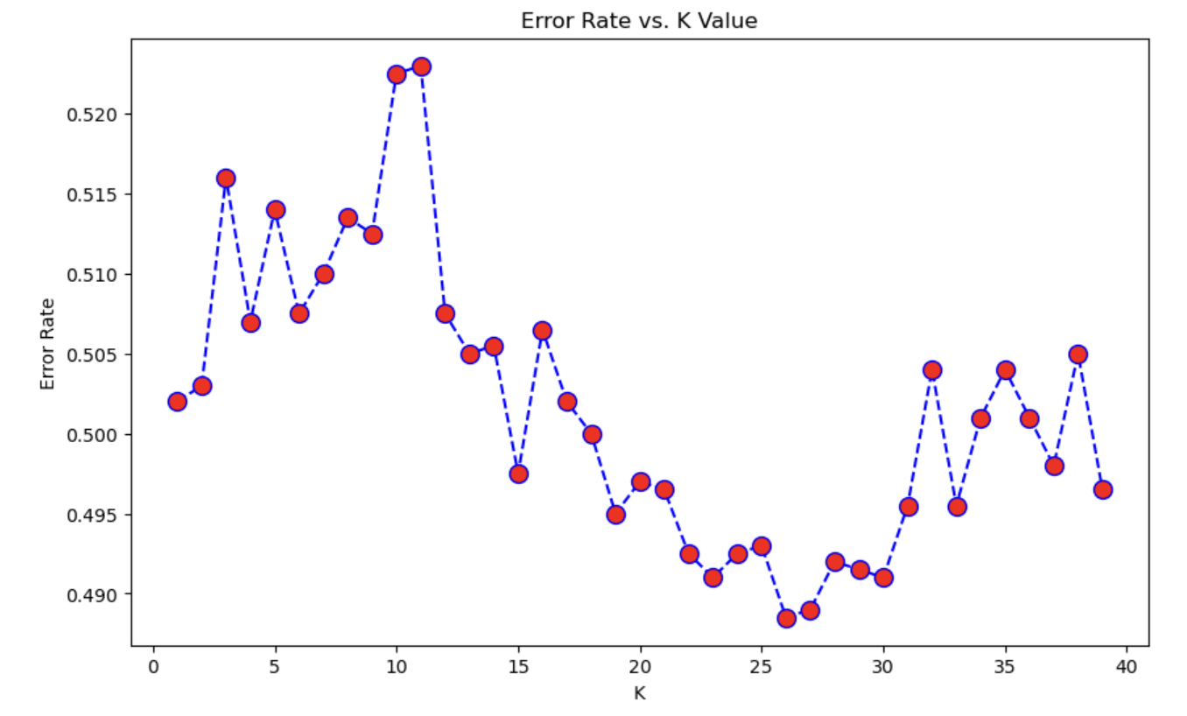
KNN Model #2
New Columns:
User Age, User Gender, User Location, Payment Method, Shipping Method
Find more customer segmentation focus
Best k = 26
Notes:
Anci
Since the last test did not give super great insights, I tried another KNN model with different data columns. This time I tried using it to find if specific customers were prone to returning products than others. Depending on their ages, gender, where they live, how they choose to pay and what shipping method they used I was hoping to find if customer behavioral patterns can help provide better business insight into why products are returned.
The k for this test was 26, a bit higher than the last one meaning that the model is looking at more points around each point to assign a label

Slide 17
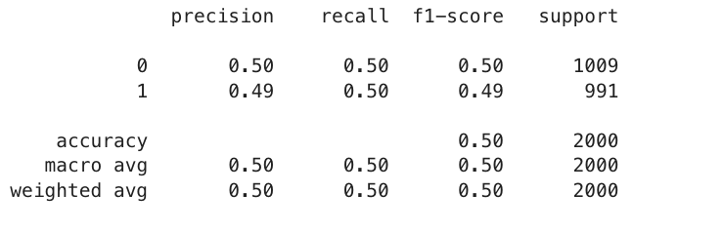
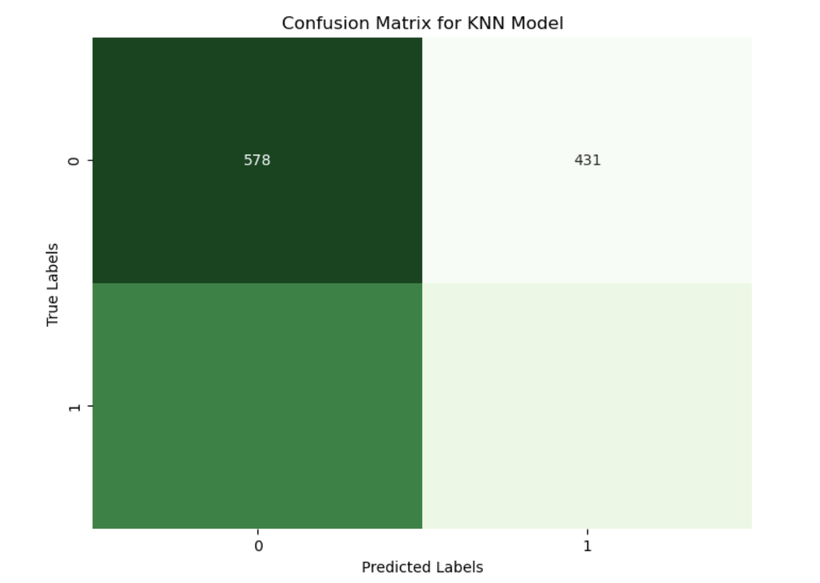
KNN Model #2 Evaluation
504
505
50% accuracy
Difficult differentiating
Possibly not the best method for this data and purpose
499
492
Notes:
Anci
Using the limited consumer behavior data we had, the data set was not entirely able to have valuable segmentation. Applying this to a more specific data set that has more demographic data may answer the business question better, it was difficult to do with what we had.
Also, this test can be helpful for more numeric data but as we can see, it is not as telling with encoded or simple values since KNN is distance value based.
While this test did not produce many strong actionable insights, they show a good starting point that we can tailor for more specific studies in the future. To focus on returns based on behaviors, data collection might include how often they place orders, if they return any previous orders, how long their transactions take and more behaviorally focused data rather than the simple and generic columns we have currently.

Slide 18
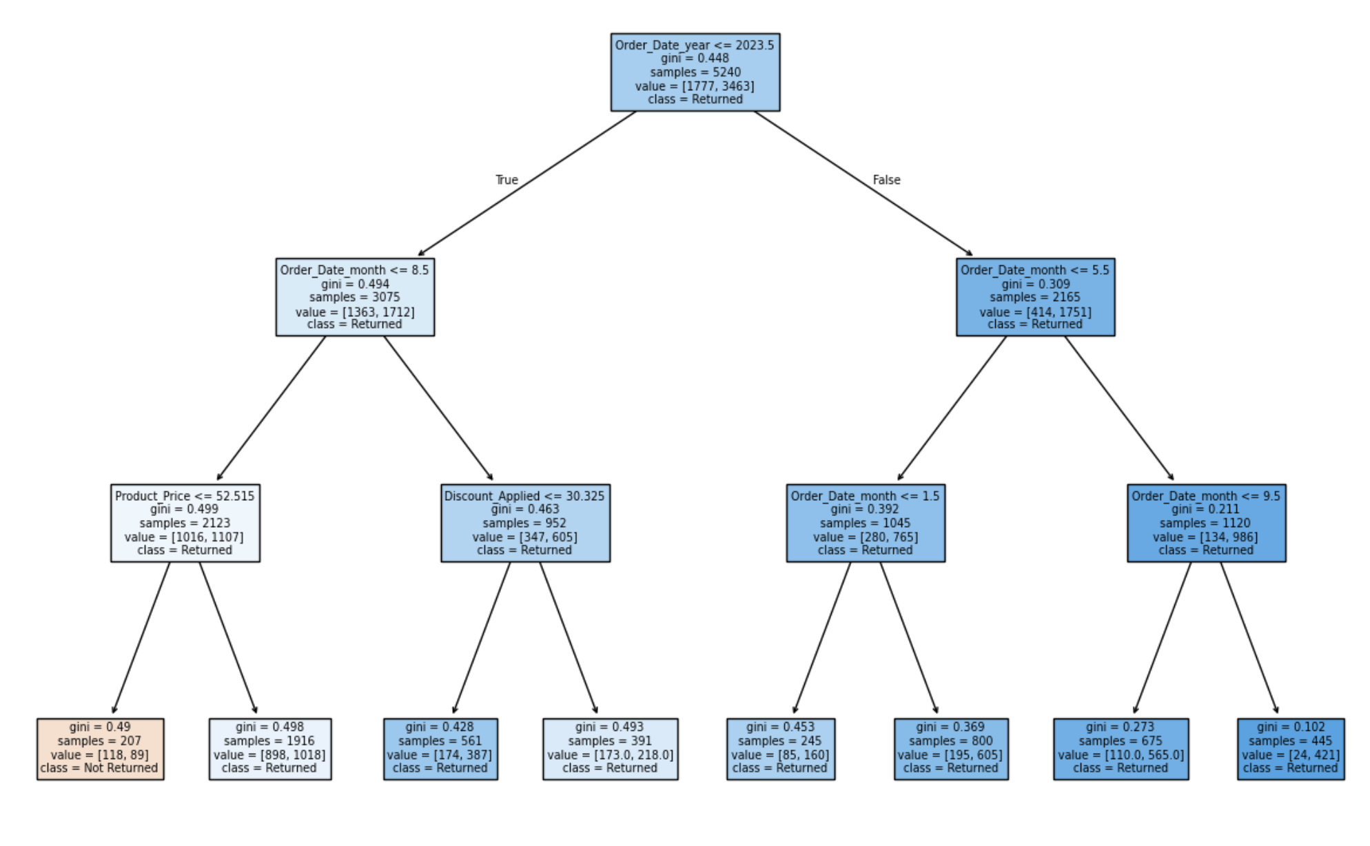
Decision Tree
Notes:
Isabella

Slide 19
How the Decision Tree makes predictions
Most orders are classified as "Returned"
Seasonality matters → Returns are more likely in certain months
Discounts & Prices: Lower price and higher discounts → higher return likelihood.
Conservative Model - predicting "Returned" for most cases.
Notes:
Isabella
Returns are more likely when:
Discounts are high
Customers are younger
Product prices are lower
These patterns align with impulsive purchases or lower product satisfaction thresholds

Slide 20
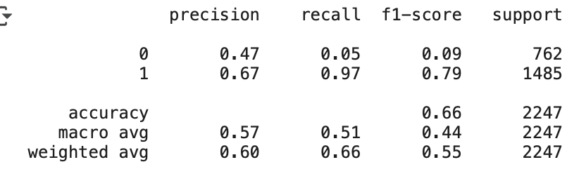
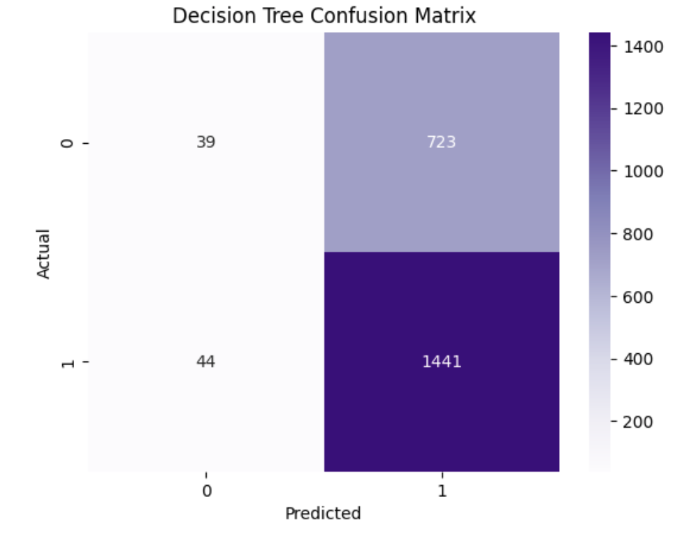
Decision Tree Evaluation
Accuracy: 66%
Recall (class 1) 97% – captures most return cases.
Recall (class 0) - model tends to overpredict returns.
Notes:
Isabella

Slide 21
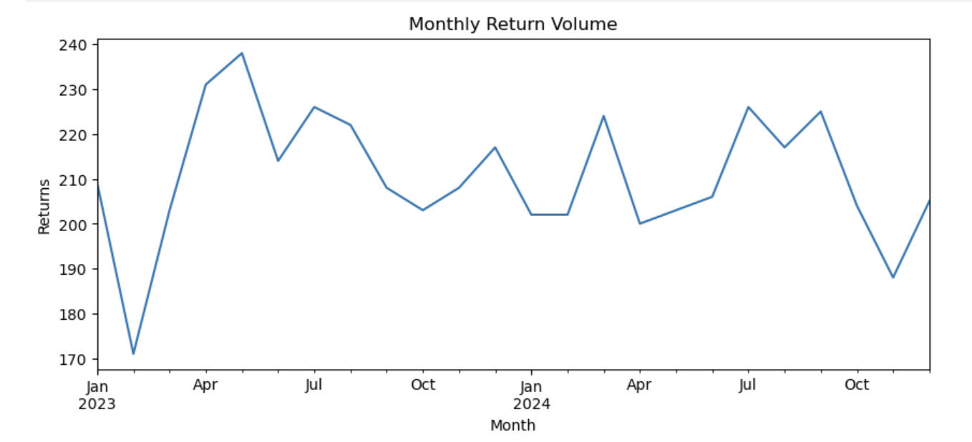
Predicting Seasonal Returns
Used STL
Current monthly returns
Lowest returns in February and November
Highest between April-May
Moderate spikes
Notes:
Isabella
After implementing the models, we would evaluate their performance ( For Classification (Delivery Status)
Accuracy: Overall percentage of correct predictions
Precision: How many predicted returns were actually returns
Recall: How many actual returns were correctly identified (important if returns are rare)
F1 Score: Harmonic mean of precision & recall
Confusion Matrix: Breakdown of TP, TN, FP, FN
or Regression (Shipping Fee)
MAE (Mean Absolute Error): Average size of errors
MSE (Mean Squared Error): Penalizes larger errors more
RMSE (Root MSE): Easier to interpret in real value terms
R² Score: How much variance the model explains

Slide 22
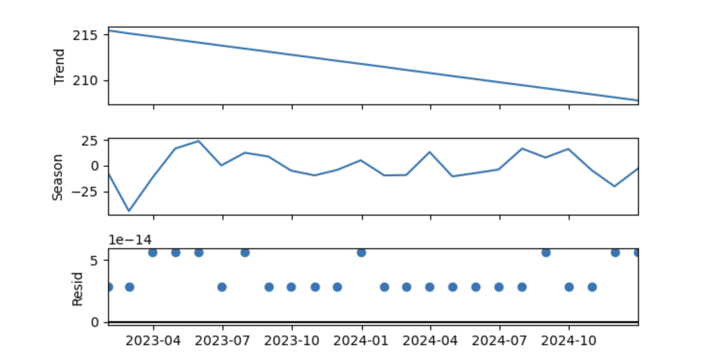
Seasonal Trend Analysis
Isolate seasonality: Returns consistently rising in January or dropping in September
Understand trend shifts: Spot gradual decline or growth
Identify anomalies: Residuals highlight unexpected deviations, such as sudden spikes due to a promotion or logistics issue
Notes:
Isabella
Trend: There's a clear decline in return volumes over time, suggesting improved product satisfaction, better sizing guides, or changes in return policy.
Seasonality: Monthly fluctuations are pronounced, possibly indicating post-holiday spikes or cyclical behavior tied to product categories or promotional calendars.
Residuals: Relatively low and stable, meaning the model captures most of the structure — which is excellent for forecasting.
Actionable Business Insights
This breakdown gives stakeholders fuel for strategic decisions:
Optimize staffing and inventory during high-return months.
Design targeted retention strategies around peak return periods to reduce churn.
Refine promotional timing by linking discounts and campaigns to low-return months.
Validate product improvements if the declining trend reflects lower defect rates or better UX.

Slide 23
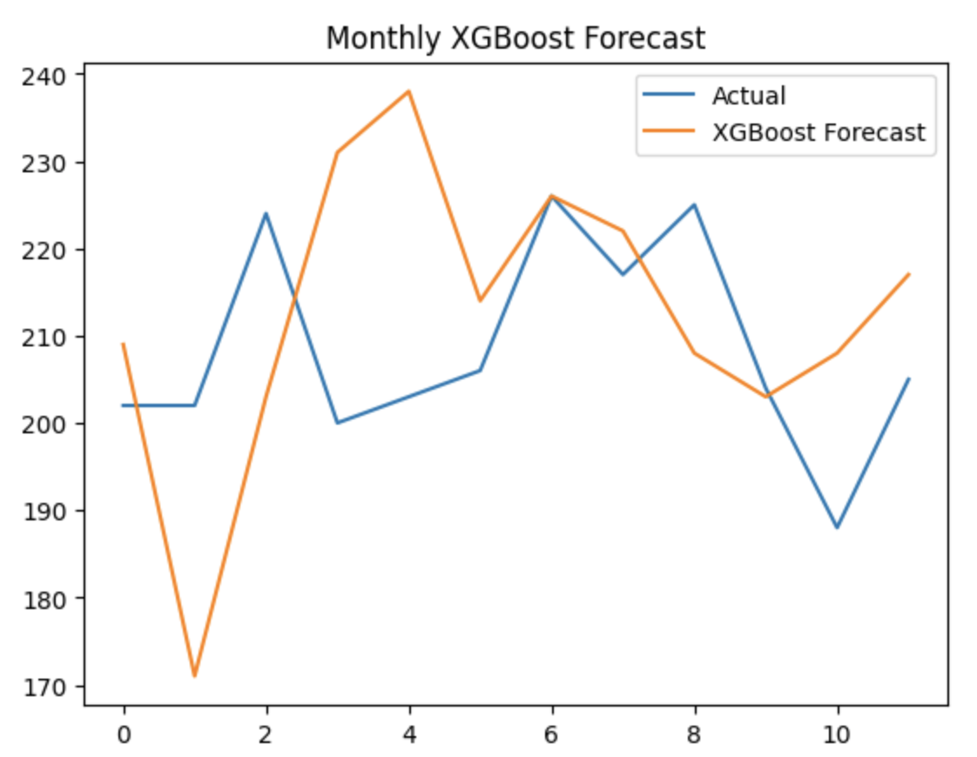
Monthly XGBoost forecast
XGBoost used to predict monthly product return volume
Captures seasonal patterns and overall trends decent
Forecast closely follows actuals in months 5–8
Slightly under- or over-predicts during sharp spikes
Notes:
Isabella

Slide 24
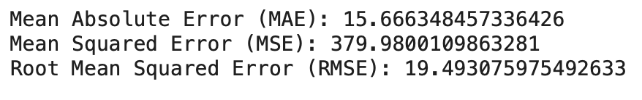
Monthly XGBoost Performance
Mean Absolute Error (MAE): 15.66
Root Mean Squared Error (RMSE): 379.98
On average, predictions are off by about 15-20 returns per month - room for improvement.
Notes:
Isabella

Slide 25

Monthly XGBoost
R² = –1.97 the model performs worse than a baseline mean forecast
Indicates poor generalization on test data
Limited data points or missing time-aware features
Notes:
Isabella

Slide 26
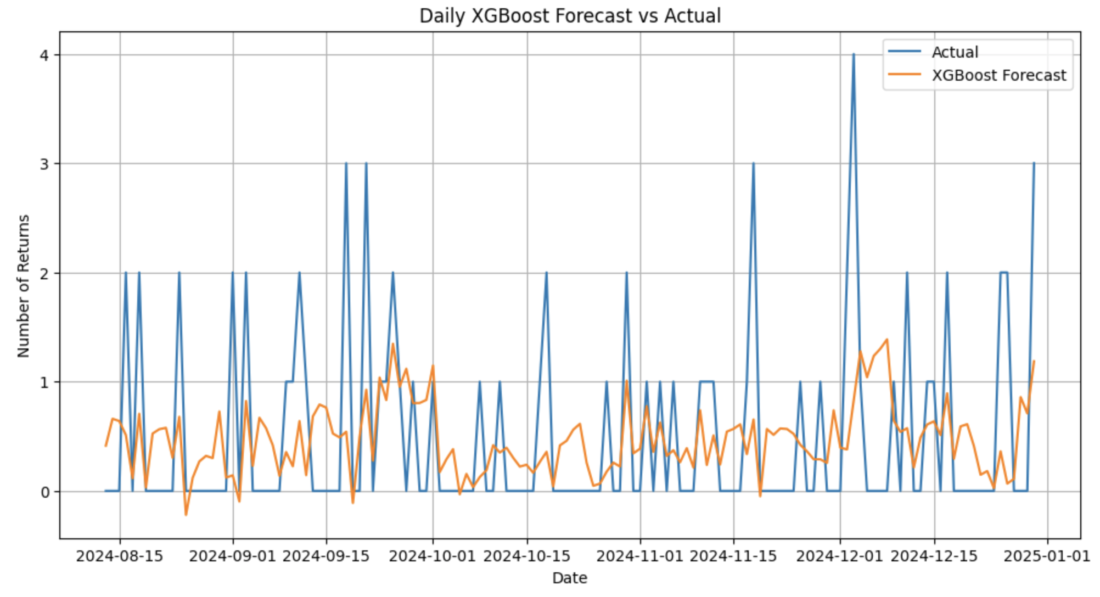
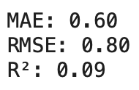
Daily XGBoost with Features
Does okay in capturing short-term patterns, but some volatility is missed
R² = 0.09 - explains 9% of variance modest - improvement
On average predictions are off by <1 per day
Notes:
Isabella

Slide 27
Insights on Features
Top Influencing Features:
ST_rolling_mean_7 (7-day avg): Most influential
Lag_30: Prior 30-day return behavior
Lag_14, Lag_7, Lag_1: Recent return patterns
Business Insight:
Return volume is driven by historical momentum
Suggests potential cyclical behavior
Business can prepare for recurring spikes in returns
Notes:
Isabella

Slide 28
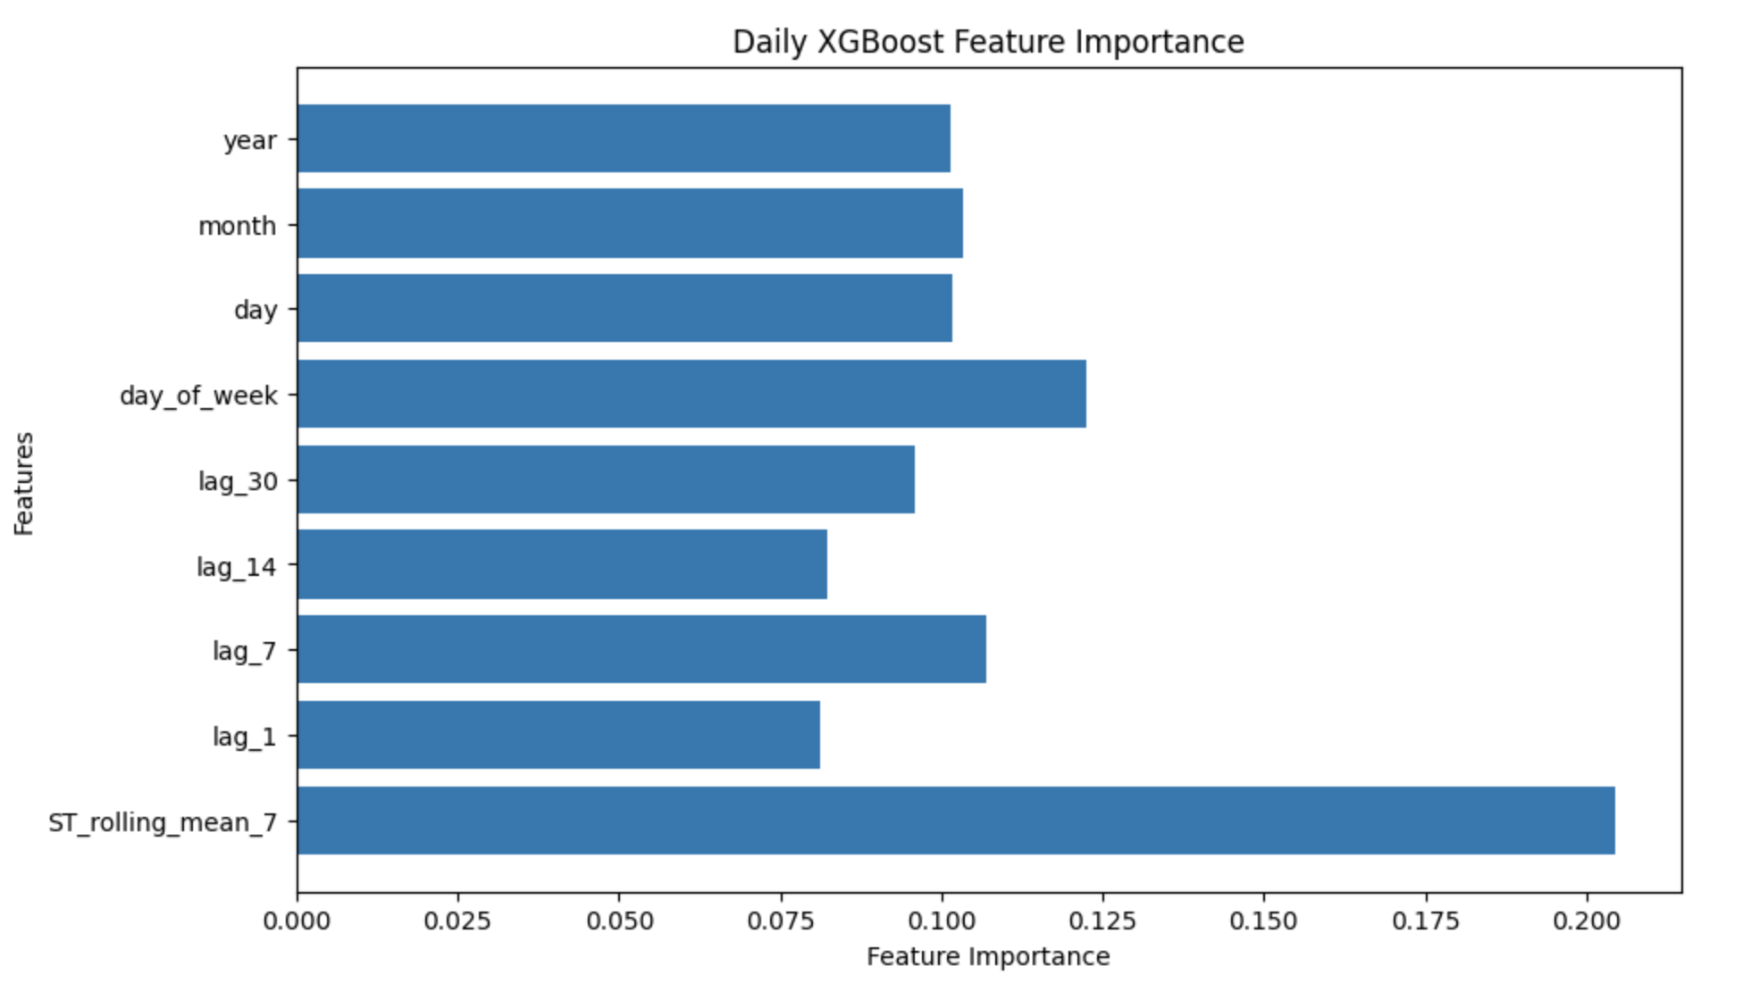
Features importance
Rolling average dominates - short-term trends matter most
Day-of-week matters more than exact date or month - suggesting weekly rhythms in return behavior
Lag features are all relevant - model relies on historical return patterns
Notes:
Isabella

Slide 29
Summary
Question: How can we use analytics to adjust ecommerce business strategies?
Prediction of Returns – Random Forest
Categorical Returns – Data Exploration
Return based on Segmentation – K Means
Forecasting – SARIMA
Notes:
Nick

Slide 30
Key Insights
Return by Category: Home, Electronics and Toys showed rates near or above 67%
Pricing Patterns: No strong impact on returns
Seasonality of Returns: Peaked between April-May and dropped in February and November
Model Outcomes:
Random Forest 65% accurate
KNN 50% accuracy
Decision Tree 66% accurate
XGBoost R² of 9% (varience)
Notes:
Return Behavior by Category: Home, Electronics, and Toys all showed return rates near or above 67%, with Clothing and Books closely behind — indicating category-specific tendencies.
Pricing Patterns: Higher-priced items weren’t immune to returns, with Clothing and Toys topping average purchase price, yet still showing high return rates.
Seasonality of Returns: Return volumes peaked between April–May and dropped in February and November, revealing cyclical customer behaviors.
Driver Analysis via Decision Tree: High discounts and younger users were more prone to return items, suggesting that promotional strategies and demographic targeting may influence return risk.
Modeling Outcomes:
Random Forest performed best (~65% accuracy) and provided meaningful feature importance for predictive analytics.
KNN models struggled to differentiate return behavior, even with demographic enrichments (~50% accuracy).
SARIMA provided solid forecasting metrics (MAE: 15.67, RMSE: 19.49), validating its use in predicting future monthly return volumes.

Slide 31
Deployment
Operational Planning
Forecasts can help inventory warehouse space
Improve customer service return processing
Strategic Implications
Time promotions with low return months
Life Cycle Management
Identify high-risk return items and decide new price points or lower/smaller stock
Customer Segmentation
Gather more information for better customer clustering
Notes:
Nick
Operational Planning: SARIMA forecasts can help optimize warehouse space and return staffing ahead of seasonal surges.
Strategic Promotions: Insights from the Decision Tree and category-level return rates can refine discount strategies — reducing return likelihood among price-sensitive buyers.
Product Lifecycle Management: Data-driven identification of high-risk product categories enables better vendor negotiations or policy adjustments.
Customer Segmentation: Though KNN wasn’t highly accurate, it hints at the potential of exploring more advanced segmentation (e.g., clustering or deep learning) for nuanced targeting.

Slide 32
Limitations and Improvements
Model Accuracy
Feature Engineering (gather more specific data, break into smaller and more meaningful sets)
Data Scope: 10,000 rows
Return Reasons: inquire further with defective products and what wrong products were
Deployment Readiness: more iterations and tuning can make feedback loops better for predictions
Notes:
Nick
•Model Accuracy Constraints: Accuracy levels below 70% (for all models) suggest room for methodological refinements — feature engineering, hyperparameter tuning, or ensemble methods could help.
Data Scope: The dataset was limited to 10,000 rows and lacked granularity in user behavior (e.g., browsing time, cart abandonment).
Return Reasons: While return reasons existed, they weren’t fully leveraged for interpretability — perhaps a text mining or sentiment analysis approach could enrich context.
Deployment Readiness: Evaluation metrics are promising but not production-grade; future iterations could integrate real-time data feeds and user feedback loops to adapt predictions dynamically.

